Slide 1
Entity Framework Debugging using SQL Server
A Detective Story

Slide 2

Story

Slide 3

Hello
Team Leader at
Rocket Homes

Slide 4
I am not a dba!

Slide 5

We are not going to attack DBA’s Here!

Slide 6

What we want to solve?

Slide 7


Goals for this talk!
Better use of the tools for SQL Server
Better use of Entity Framework Core for performance and happier users
Better relationship with your DBA’s!

Slide 8
Query Plans
Estimated Execution Plan
compiled plan, as produced by the Query Optimizer based on estimations
compiled plan plus its execution context. It becomes available after the query execution has completed.
includes actual runtime information such as execution warnings, or in newer versions of the Database Engine, the elapsed and CPU time used during execution
Live Query Statistics
compiled plan plus its execution context
includes runtime information such as the actual number of rows flowing through the operators, elapsed time, and the estimated query progress
Actual Execution Plan
stored in the plan cache

Slide 9
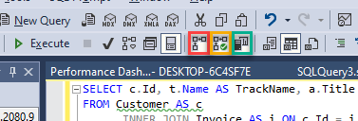
How to look at Query Plans
Actual Execution Plan
Live Query Statistics
Client Statistics

Slide 10
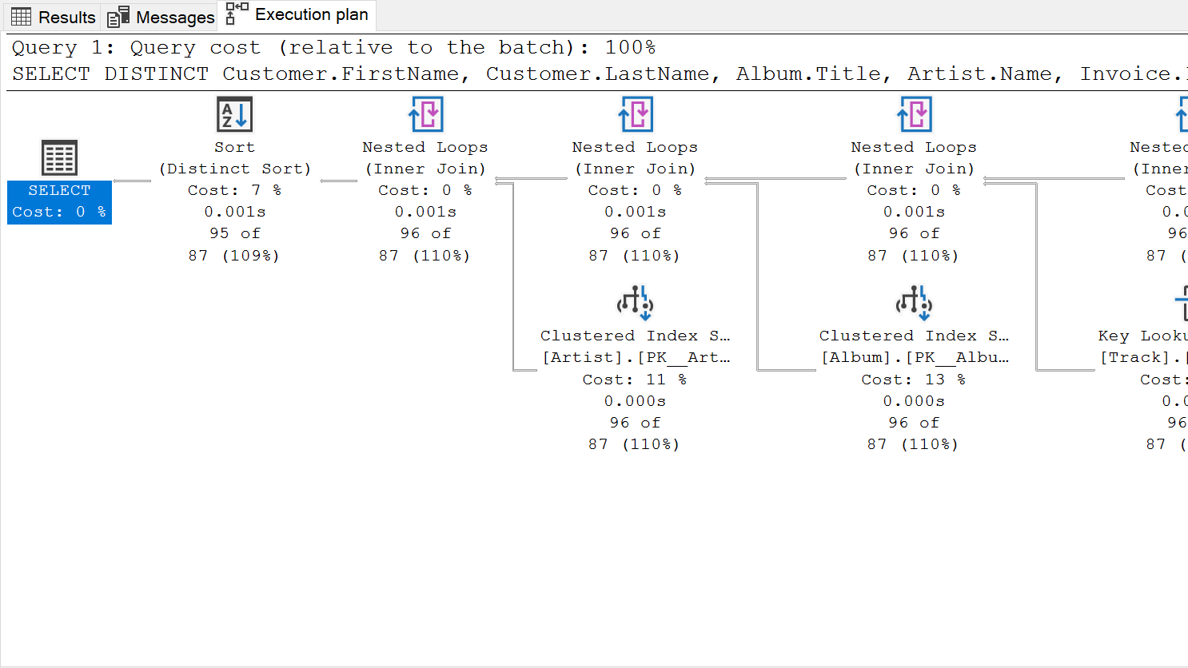
Detective Tip #1 – understand query Plans

Slide 11
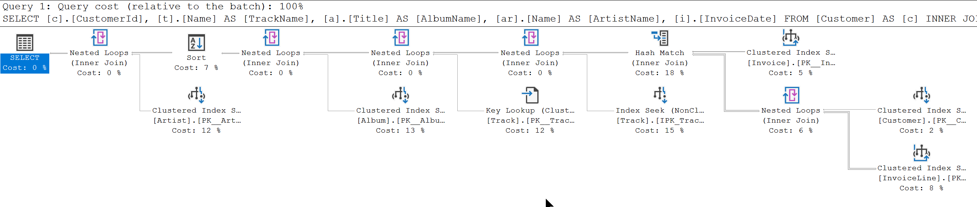
SELECT c.Id, t.Name AS TrackName, a.Title AS AlbumName, ar.Name AS ArtistName, i.InvoiceDate
FROM Customer AS c
INNER JOIN Invoice AS i ON c.Id = i.CustomerId
INNER JOIN InvoiceLine AS il ON i.Id = il.InvoiceId
INNER JOIN Track AS t ON il.TrackId = t.Id
INNER JOIN Album AS a ON t.AlbumId = a.Id
INNER JOIN Artist AS ar ON a.ArtistId = ar.Id
WHERE c.Id = 2
ORDER BY AlbumName

Slide 12
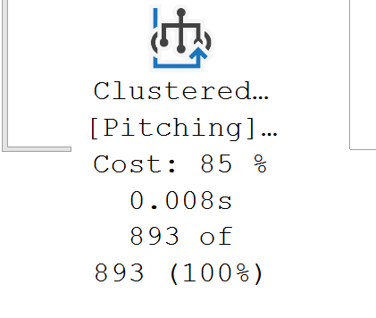
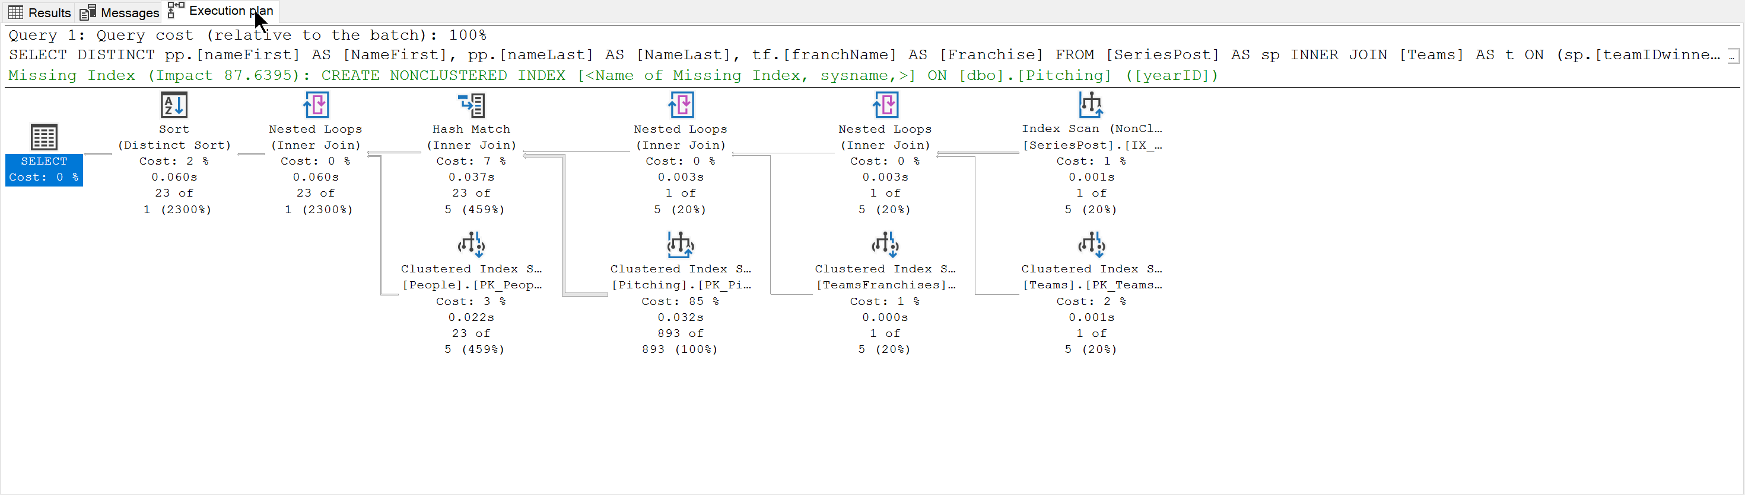
SELECT DISTINCT pp.[nameFirst] AS [NameFirst], pp.[nameLast] AS [NameLast], tf.[franchName] AS [Franchise]
FROM [SeriesPost] AS sp
INNER JOIN [Teams] AS t
ON (sp.[teamIDwinner] = t.[teamID]) AND (sp.[lgIDwinner] = t.[lgID]) AND (sp.[yearID] = t.[yearID])
INNER JOIN [TeamsFranchises] AS tf
ON t.[franchID] = tf.[franchID]
INNER JOIN [Pitching] AS p
ON (t.[teamID] = p.[teamID]) AND (t.[lgID] = p.[lgID]) AND (t.[yearID] = p.[yearID])
INNER JOIN [People] AS pp
ON p.[playerID] = pp.[playerID]
WHERE (sp.[round] = 'WS') AND (sp.[yearID] = 2020)

Slide 13
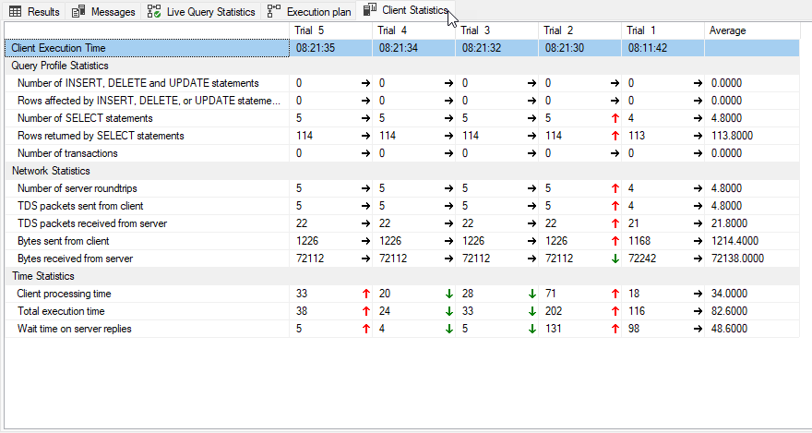
Client Statistics

Slide 14

Detective Tip #2 – Query Tags and Extended Events

Slide 15
Query Tags
var albums = _context.Album.Include(a => a.Artist) .TagWith("Description: Query for Albums") .TagWith("Query located: Chinook.Controllers.AlbumsController.Index() method") .TagWith(@"Parameters: None");

Slide 16
Query Tags
-- Description: Query for Albums
-- Query located: Chinook.Controllers.AlbumsController.Index() method
-- Parameters:
-- None
SELECT [a].[Id], [a].[ArtistId],
[a].[Title], [a.Artist].[Id], [a.Artist].[Name]
FROM [Album] AS [a]
INNER JOIN [Artist] AS [a.Artist] ON [a].[ArtistId] = [a.Artist].[Id]

Slide 17
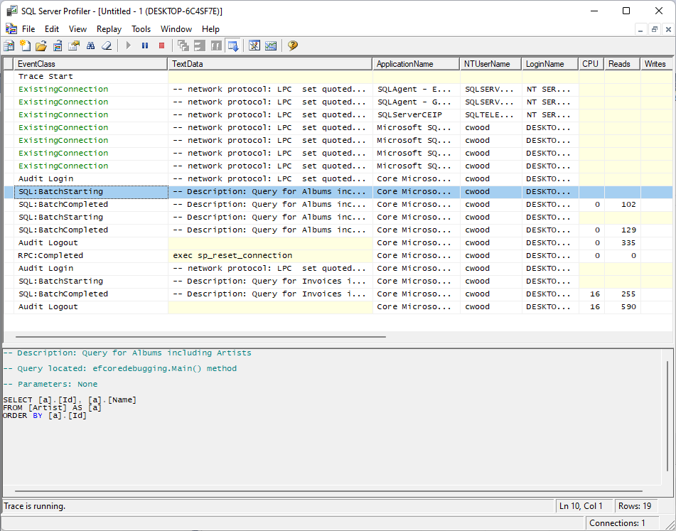
SQL Server Profiler

Slide 18
Extended Events
CREATE EVENT SESSION [ChinookAlbumQueries] ON SERVER
ADD EVENT sqlserver.sql_statement_completed(
ACTION(sqlserver.sql_text)
WHERE (
[sqlserver].[like_i_sql_unicode_string]
([sqlserver].[sql_text], N'%SELECT%ALBUM%'))
)
WITH (TRACK_CAUSALITY=ON);

Slide 19
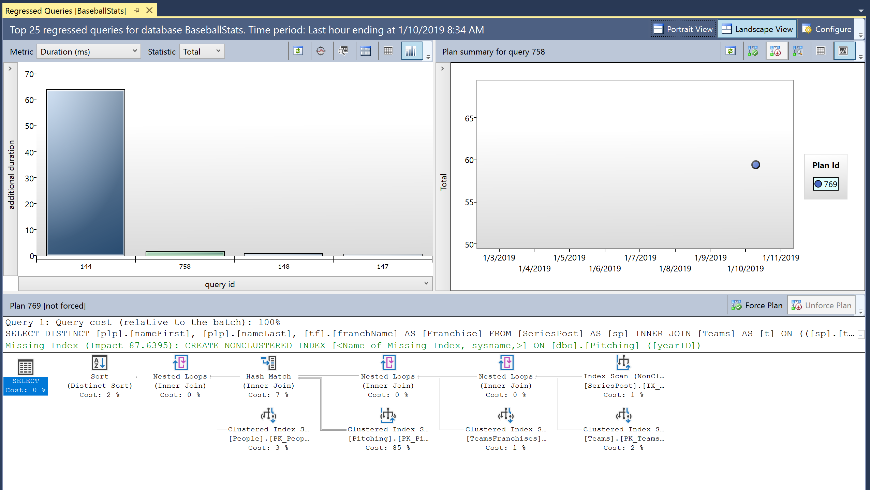
Detective Tip #3 – Learn about Query Store

Slide 20

Understanding the Query Store

Slide 21
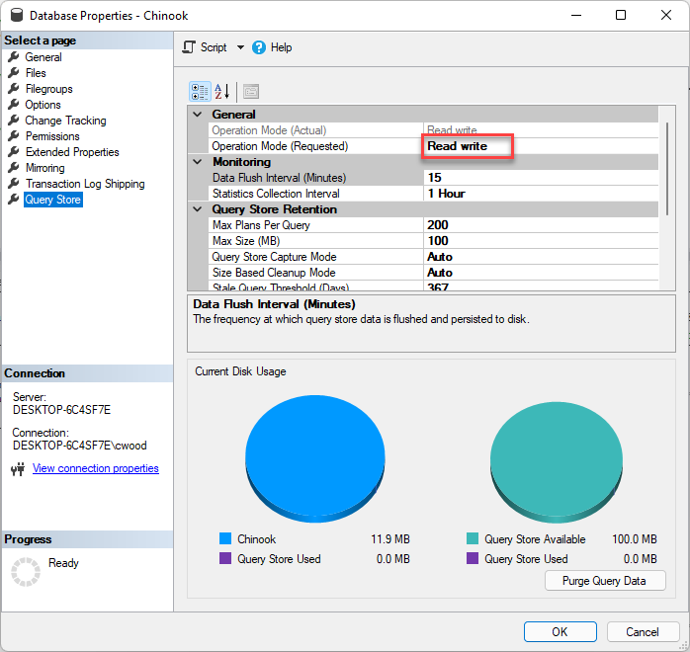
Query Store

Slide 22
Show how to enable Query Store
ALTER DATABASE Chinook SET QUERY_STORE = ON;
Notes:
Query Store is not enabled by default for new SQL Server and Azure Synapse Analytics databases, and is enabled by default for new Azure SQL Database databases.

Slide 23
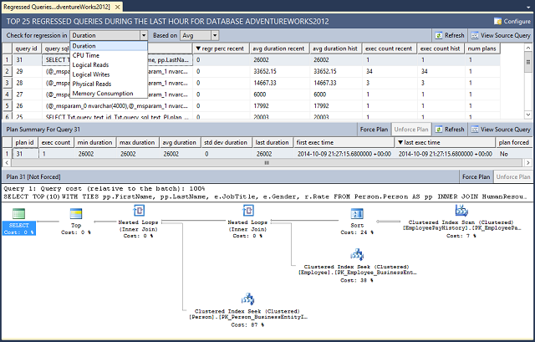
Query Store

Slide 24

Detective Tip #4 – What we can do to improve our EF queries

Slide 25
String interpolation in raw SQL methods
var city = “London";
using (var context = CreateContext())
{
context.Customers.FromSql($@“
SELECT *
FROM Customers
WHERE City = {city}");
}
var city = " London ";
using (var context = CreateContext())
{
FormattableString query =
$@“SELECT *
FROM Customers
WHERE City = {city}";
context.Customers.FromSql(query);
}
SELECT *
FROM Customers
WHERE City = @p0

Slide 26
Explicitly Compiled Queries
private static readonly Func<ChinookContext, AsyncEnumerable<Album>> _queryGetAllAlbums = EF.CompileAsyncQuery((ChinookContext db) => db.Album);
public async Task<List<Album>> GetAllAlbumsAsync() => await _queryGetAllAlbums(this).ToListAsync();

Slide 27
DbContext Pooling
DI Container
public class AlbumRepository : IAlbumRepository
{
private MyDBContext _context;
public AlbumRepository(MyDBContext context)
{
_context = context;
}
public async Task<List<Album>> GetAllAsync()
=> await _context.Album.ToListAsync(ct);
}
Request: /blogs/index
Scope
BlogContext
Blogs
Controller
Request: /blogs/index
Scope
BlogContext
Blogs
Controller
Request: /blogs/index
Scope
BlogContext
Blogs
Controller
Notes:
Many ASP.NET Core applications can now obtain a performance boost by configuring the service registration of their DbContext types to use a pool of pre-created instances, avoiding the cost of creating new instance for every request:

Slide 28
DbContext Pooling
DI Container
public class AlbumRepository : IAlbumRepository
{
private MyDBContext _context;
public AlbumRepository(MyDBContext context)
{
_context = context;
}
public async Task<List<Album>> GetAllAsync()
=> await _context.Album.ToListAsync(ct);
}
Request: /blogs/index
Context Pool
Scope
BlogContext
BlogContext
Scope
Blogs
Controller
BlogContext
BlogContext
BlogContext
Request: /blogs/index
BlogContext
BlogContext
Blogs
Controller
Scope
Request: /blogs/index
Scope
BlogContext
Blogs
Controller

Slide 29
DbContext Pooling
services.AddDbContext<BloggingContext>( options => options.UseSqlServer(connectionString));
services.AddDbContextPool<BloggingContext>( options => options.UseSqlServer(connectionString));

Slide 30

Be nice to your DBA!

Slide 31

Wrap Up!

Slide 32
Thanks!!!
cwoodruff@live.com
https://github.com/cwoodruff/DebugEFCoreWithMSSQL

